Slide 1
Pan European reference data Core Reference Data
ESTAT –E4 – Hannes I. Reuter
ESTAT-GISCO

Slide 2
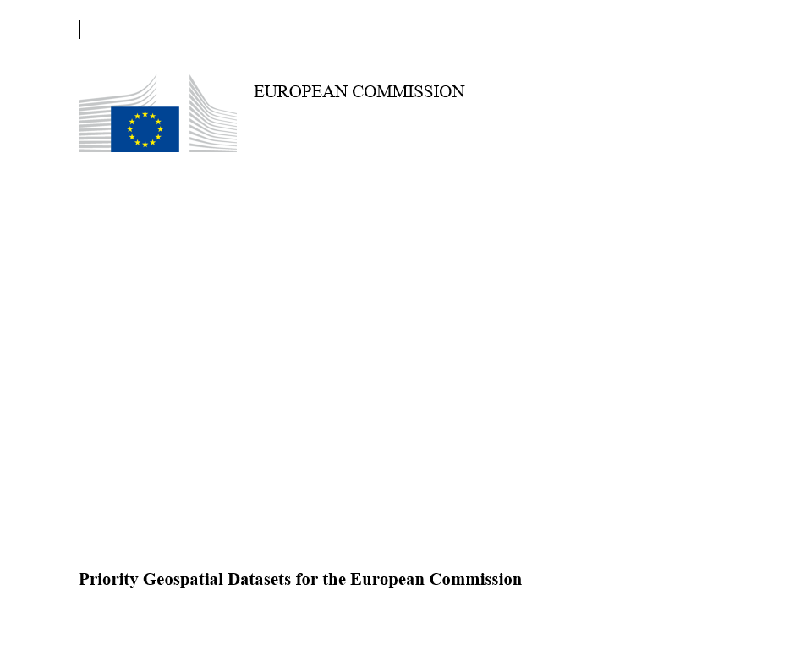
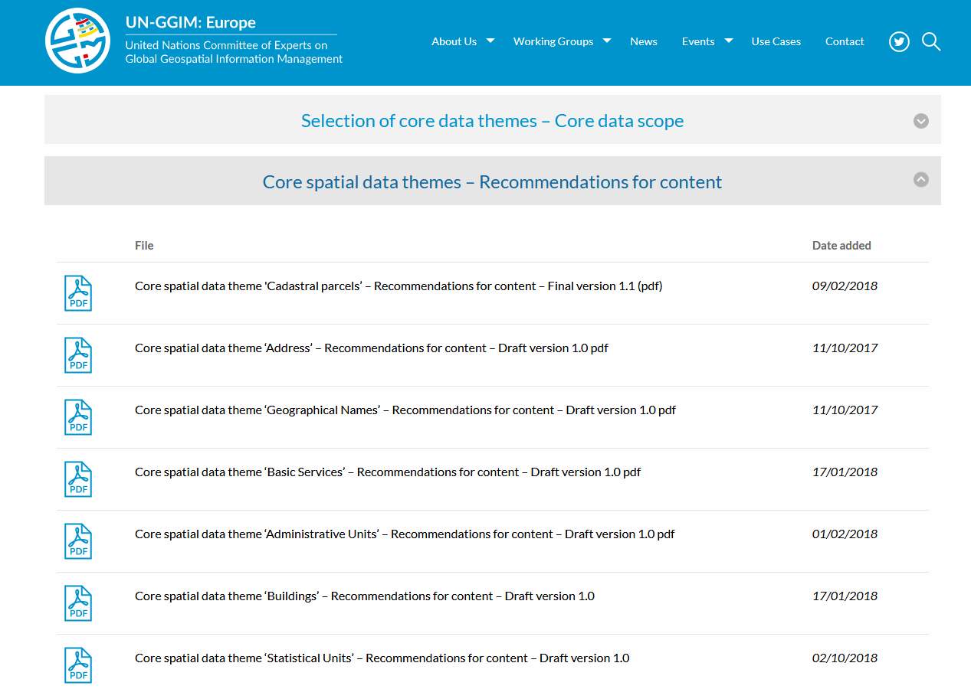
EC Geospatial Data Requirements (I)
Internal EC Consensus document outlining the EC needs for geospatial data
(Document for information and not approval)
…to provide a consolidated and consistent overview of the European Commission user needs and set out cross-cutting and domain specific requirements of the European Commission for EU wide geospatial information and data products from Member States in support to Sustainable Development and other EU policies….

Slide 3
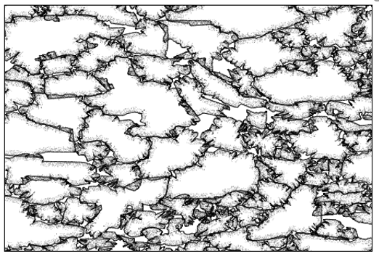
EC Geospatial Data Requirements (II)
PC
Buildings (BU),
Cadastral Parcels (CP),
Addresses (AD),
Administrative units (AU),
Statistical Units (SU),
Transport Networks (TN),
Land Parcel Information System (LPIS)
Postal Codes (PC)
Utility and governmental services (US)

Slide 4
General Requirements for data themes
Unique and persistent identifier
full geographic extent of the territory
at the scale ~1: 5000-10.000
update frequency (incremental) should be once a year or better
INSPIRE mechanism of life-cycle attributes and versioning / Update only for the future
IN, AG , QA, DI

Slide 5
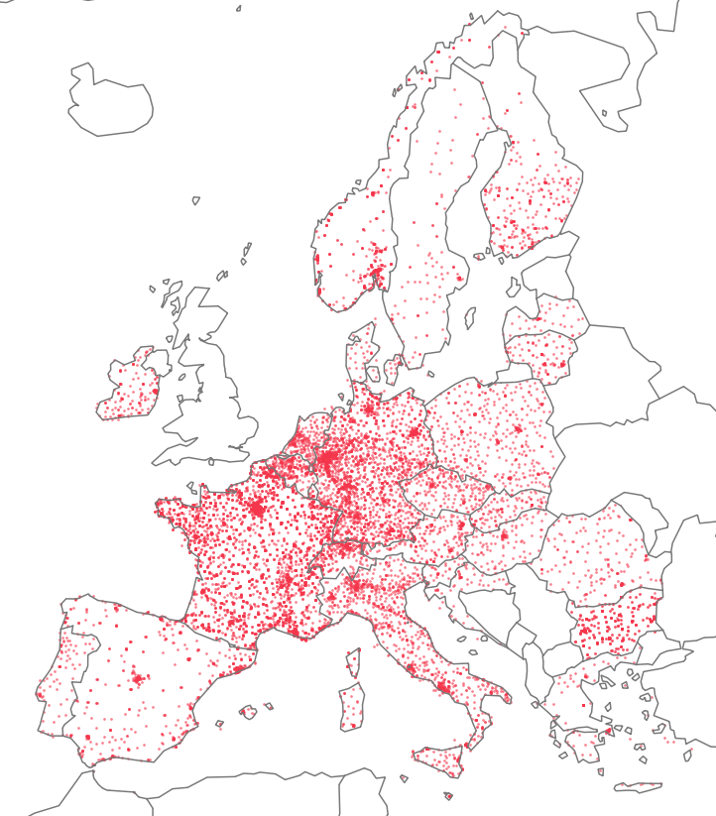
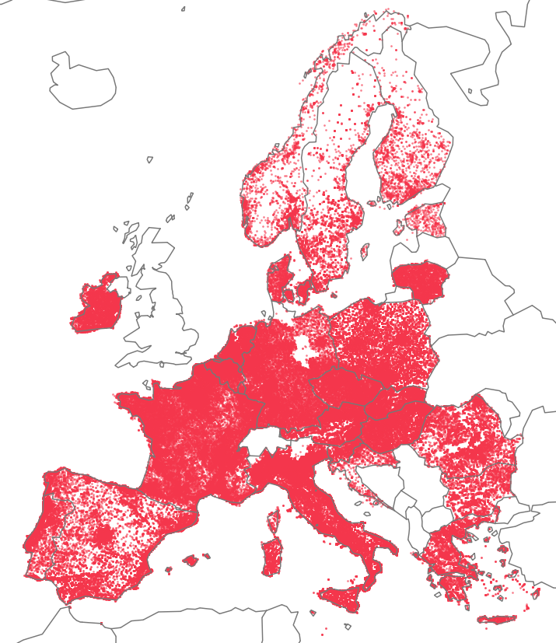
EC Geospatial Data Requirements (III)
DI
QA
Healthcare
Education
DI
https://ec.europa.eu/eurostat/web/gisco/geodata/reference-data/healthcare-services

Slide 6
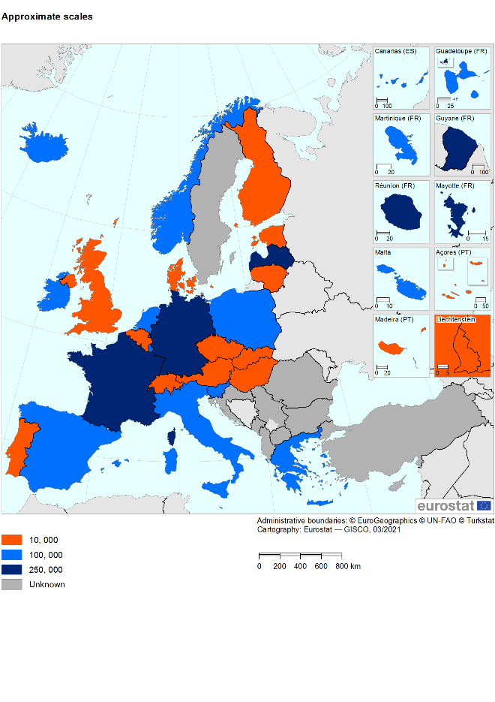
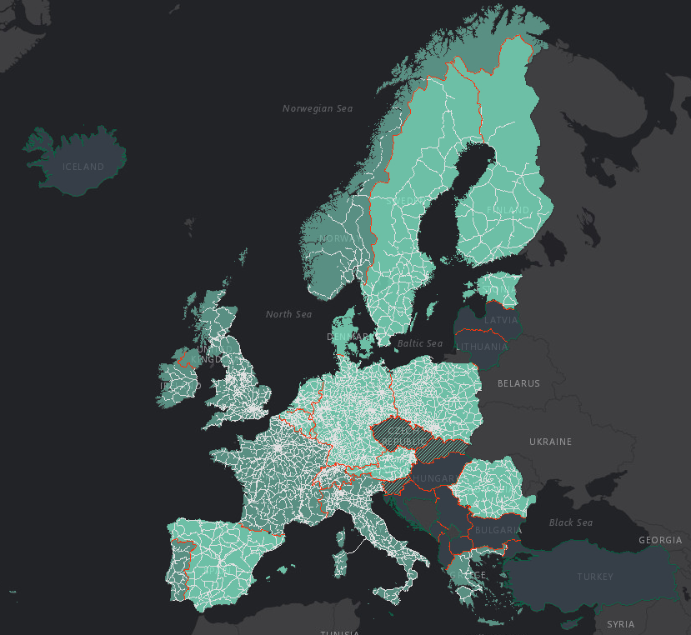
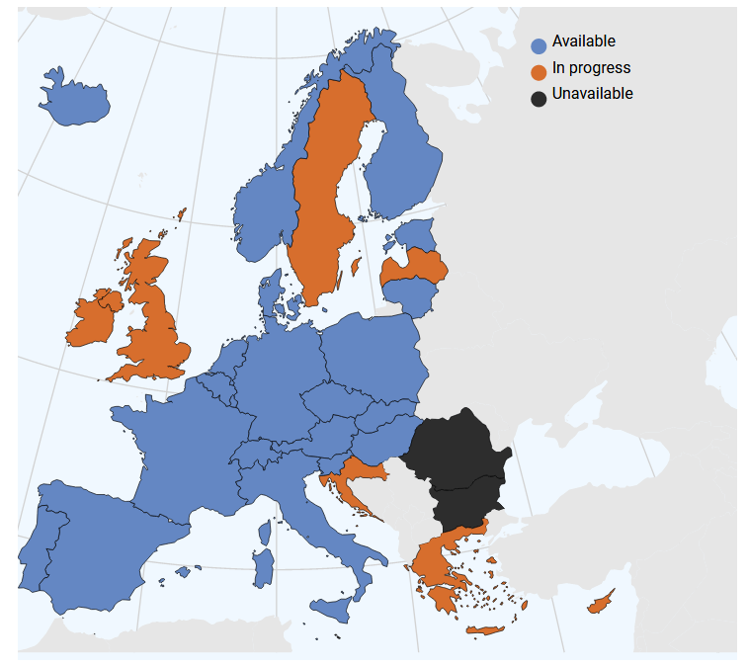
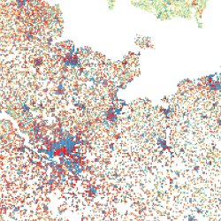

EC Geospatial Data Requirements (IV)
AD
GRID
AU
BD

Slide 7
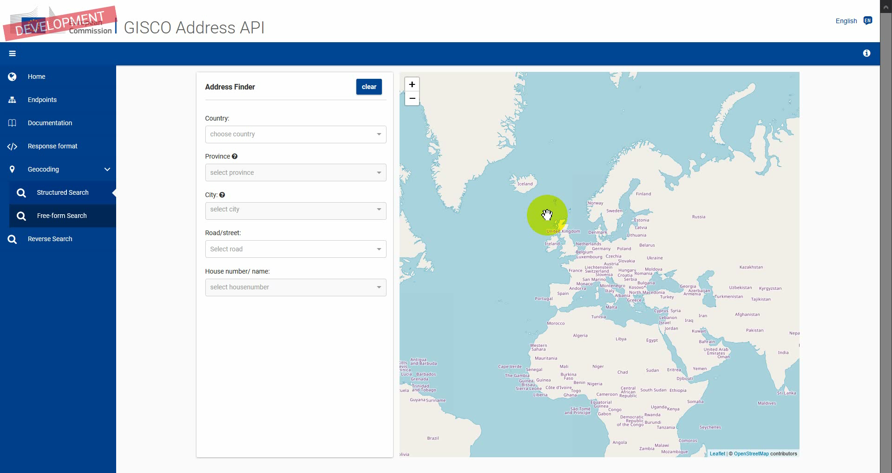
EC Geospatial Data Requirements (V)
QA

Slide 8
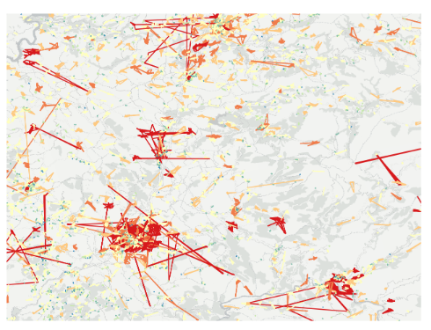
Core Reference Data Summary
AD
Document presented to INSPIRE Working Group, HVD and similar
Approved by the COGI ISG in 2020
Implementation of Compilation started –
AD, AU, POI (Healthcare and Education)
BD

Slide 9
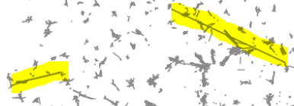
Issues observed
Metadata:
Datasets exists but are not documented - Hard to find outside organisation
Data exists locally by not centrally – Hard to find without country knowledge
Data
INSPIRE allowed us to request and easily ingest data into GISCO INSPIRE Database Schema
Various scales/ Data is outdated / several repositories of the same dataset – Who is the Master ?
Formats INSPIRE+OpenData – Richness and timeliness of data
Data is not complete, no cross checking across datasets / themes
Member states welcomed feedback on issues observed
Restrictive Licence / Access restrictions

Slide 10
How can Member States contribute?
Enhance Quality beyond INSPIRE requirements: scale, thematic coverage, temporal coherence, cross theme correspondence (Parcel,BD,AD,AU,SU);
Favourable Access and use conditions: open data, reasonable fees and rights to re-disseminate;
Increase Reactivity: speed at which new data requirements from EU services can be met (INSPIRE/UNGGIM:Europe);
Better Harmonisation: differences in the implementation and interpretation of INSPIRE make the compilation of pan-EU products difficult without further harmonisation work;
Ensure Availability of download services as-is and up to date services.

Slide 11

Thanks !
estat-gisco@ec.europa.eu

Slide 12

Thank you
© European Union 2021
Unless otherwise noted the reuse of this presentation is authorised under the CC BY 4.0 license. For any use or reproduction of elements that are not owned by the EU, permission may need to be sought directly from the respective right holders.
Notes:
Update/add/delete parts of the copy right notice where appropriate.
More information: https://myintracomm.ec.europa.eu/corp/intellectual-property/Documents/2019_Reuse-guidelines%28CC-BY%29.pdf

